Slide 1
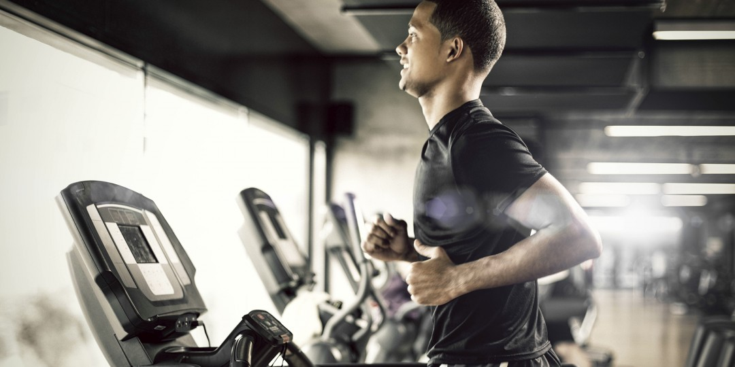
Benefits of fitness
By Maison

Slide 2
What benefits are there to fitness
The benefits of fitness are:
Increases the density of bone
Gives strength to the heart and lungs of the body
Helps in weight loss
Reduces stress
Reduce the risk of heart disease and some cancers
Gives extra energy to the body

Slide 3
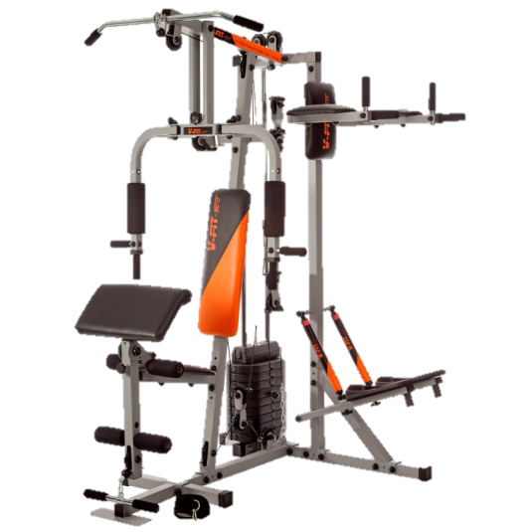
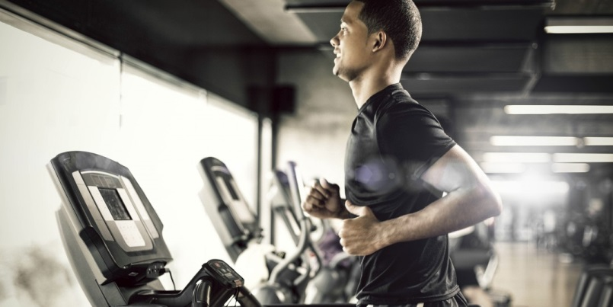
What fitness activities are there
There are:
Multi-Gym
Treadmill

Slide 4
Famous sport people

